Slide 1
MarkLogic ODI Integration Knowledge Module
Oracle to MarkLogic Data Transfer – Sample ODI IKM Code
August 19, 2016

Slide 2
What is this document?
This document provides instructions for setting up a sample Oracle Data Integration knowledge module to transfer data from an Oracle database to a MarkLogic database.
It is intended for illustration purposes only.
A video walkthrough is also available on the project’s homepage at: https://github.com/ryanjdew/odi-ikm-sql-to-marklogic

Slide 3
Initial Setup
Install ODI version 12c
Install MarkLogic version 8
The Integration Knowledge Module (IKM), IKM SQL to MarkLogic, relies on MarkLogic's XCC Java library. You can download the library from https://developer.marklogic.com/products/xcc. After downloading the zipped distribution, you'll need to copy lib/marklogic-xcc-8.0.5.jar into the ~/.odi/oracledi/userlib folder.
In order for the library to be found, the ODI Studio will need to be restarted.

Slide 4
Steps Overview
Setup a MarkLogic XDBC Server using MarkLogic Admin Console
Import the IKM SQL to MarkLogic module
Confirm the IKM SQL to MarkLogic settings for the project
Create a target Model in ODI, with a child target datastore
Define the attributes on target datastore
Create a new mapping that uses the MarkLogic ODI IKM
Run your mapping to send content from ORACLE to MarkLogic!

Slide 5
Setup a XDBC Server for ODI to Interface With
Setup a XDBC Server associated using MarkLogic Admin Console with the desired content database as described at https://docs.marklogic.com/guide/admin/xdbc#id_21458. Note that for the associated Modules database, you can select Modules.

Slide 6
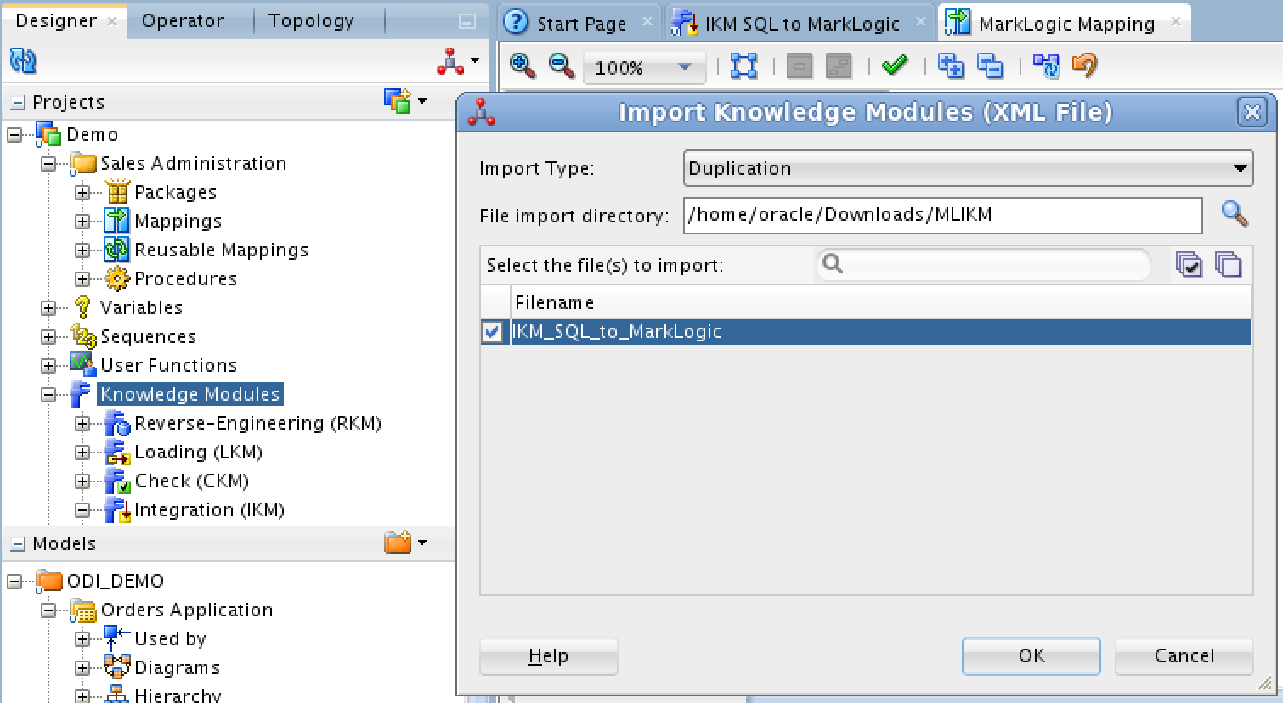
Import the IKM SQL to MarkLogic module
Import the IKM SQL to MarkLogic by right clicking on “Knowledge Modules” in ODI, selecting “Import Knowledge Module” and navigating on your local file system to where your IKM SQL to MarkLogic is located, and clicking “OK”

Slide 7
Confirm the IKM SQL to MarkLogic settings for the project
After importing the IKM, select it in ODI and choose the “Options” on the left to confirm or customize the settings of your MarkLogic instance, including whether documents are creating as JSON or XML.

Slide 8
Create a target for the data in ODI
If desired, create a new target model by right-clicking your model folder and selecting “New Model”
Create a new datastore by right-clicking the desired target model and selecting “New Datastore”

Slide 9
Define your target datastore attributes
Open the target datastore and define your desired attributes

Slide 10
Create a new Mapping
Create new Mapping by right clicking Mapping and choosing “New Mapping”
Add source and target datastores by dragging them into the mapping’s Logical view
Assign attributes by dragging them from the source attribute to the target attribute

Slide 11
Assign MarkLogic IKM to the target datastore
Change to the “Physical” view of your mapping
Select the target datastore to see its attributes. You can also override the IKM settings for this specific mapping only.

Slide 12
Run your mapping!
Run your mapping by right clicking it and selecting “Run”
See results in MarkLogic by visiting the MarkLogic Query console at port 8000 of your MarkLogic instance (e.g., http://localhost:8000/qconsole), selecting your Database and clicking the “Explore” button..

Slide 13
End of Presentation

